Slide 1

Externalizable Business Objects

Slide 2
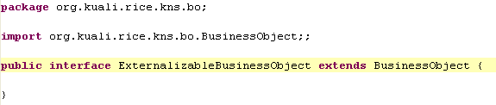
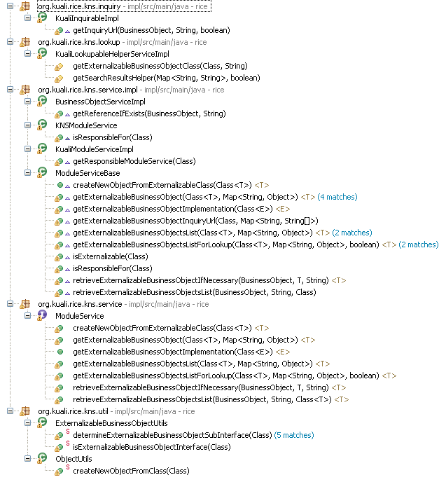

ExternalizableBusinessObject
Essentially a marker interface
Various parts of the KNS check for this interface

Slide 3
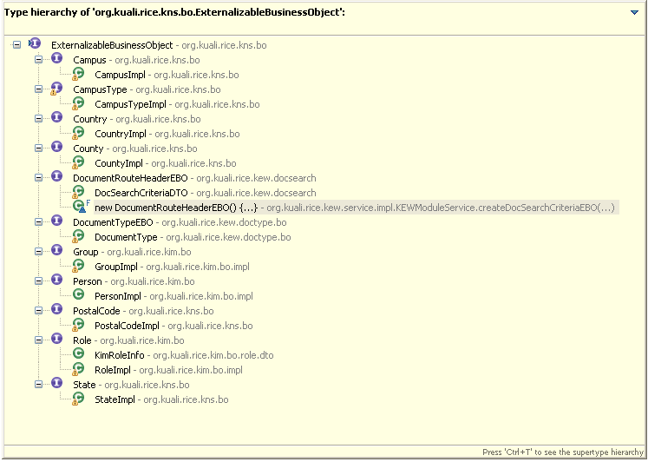
Sample Implementations in Rice

Slide 4
Uses
Allows for objects that are hosted by other systems to be used by a Rice application
  Rice
  Non-Rice
Automatic integration (with appropriate configuration) with native business objects for lookup and inquiry purposes
  Lookups can be performed on external systems
    And return results!
  Inquiries can be redirected to other systems
  Lookups on native business objects can contain “joins” to externalizable business objects.

Slide 5
Lookup Handling
The lookup framework handles when it is asked for a lookup of an externalizable business object.
  The object itself – delgates the entire lookup
  A property of an embedded EBO is used as search criteria on a native business object
In that latter case, the default behavior is to use only the EBO property criteria which were specified and pass them to the module service to look up the matching EBOs.
The resulting PK values are then merged into the native BO Query
  This system only supports EBOs with a single-field primary key.

Slide 6
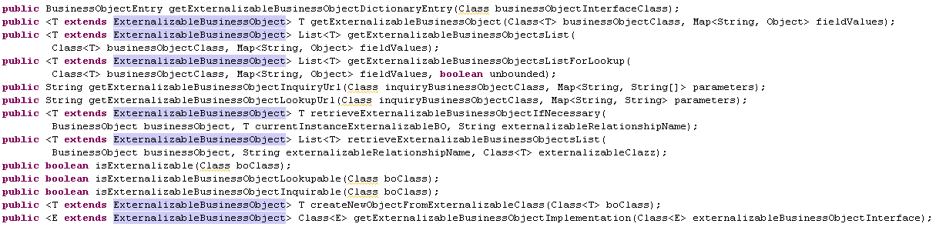
Module Service
Most are implemented for you in ModuleServiceBase
Ones you will want/need to overide are:
  getExternalizableBusinessObject
  getExternalizableBusinessObjectsList
  getExternalizableBusinessObjectsListForLookup
  listPrimaryKeyFieldNames
  getExternalizableBusinessObjectInquiryUrl
  getExternalizableBusinessObjectLookupUrl

Slide 7
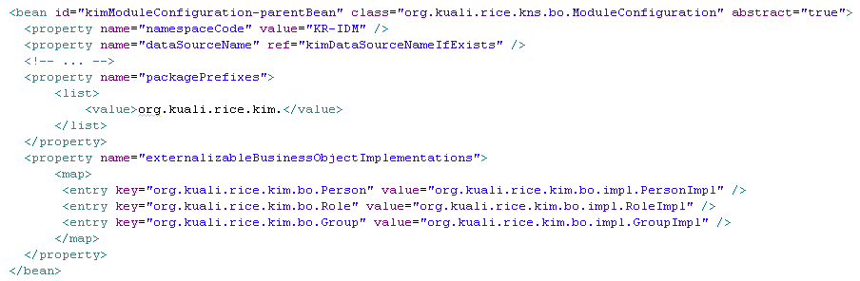
Module Service Configuration
Configure Service with ExternalizableBusinessObject interfaces and implementation pairs:

Slide 8
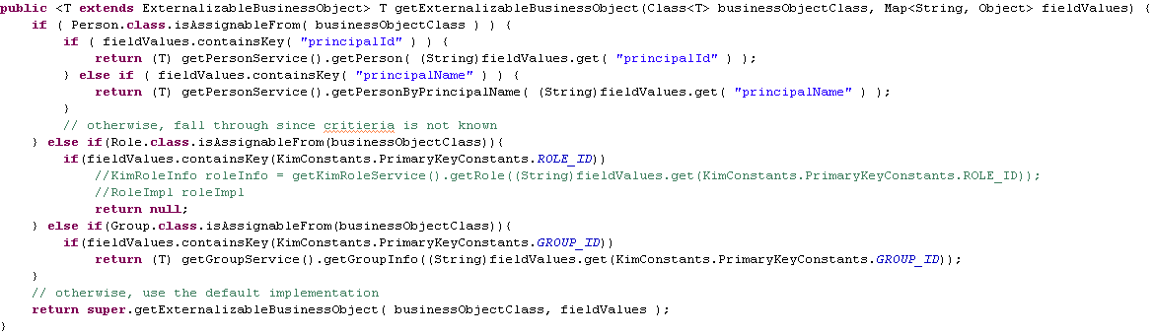
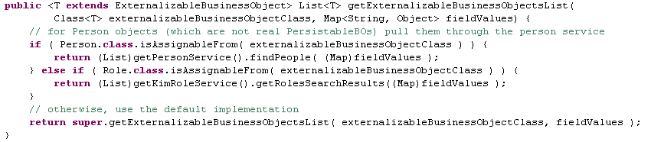
Module Service Implementation
In the methods shown earlier, detect the type of EBO and handle accordingly.

